Slide 1
Recurrent Neural Networks
CSC 249/449 Spring 2019
http://www.cs.rochester.edu/~cxu22/t/249S19/
Instructor: Chenliang Xu
chenliang.xu@rochester.edu

Slide 2
Feedforward v.s. Recurrent NN
Activation is fed forward from input to output through “hidden layers” (multilayer perceptron).
A network that is more similar to biological NN.
Static input-output mappings.
Approximates arbitrary nonlinear mappings with arbitrary precision.
Implements dynamical systems.
Approximates arbitrary dynamical systems with arbitrary precision.
Can be trained with BP.
Can be trained with BP through time.
Feedforward NN
(multilayer perceptron
or CNN)
Recurrent NN

Slide 3
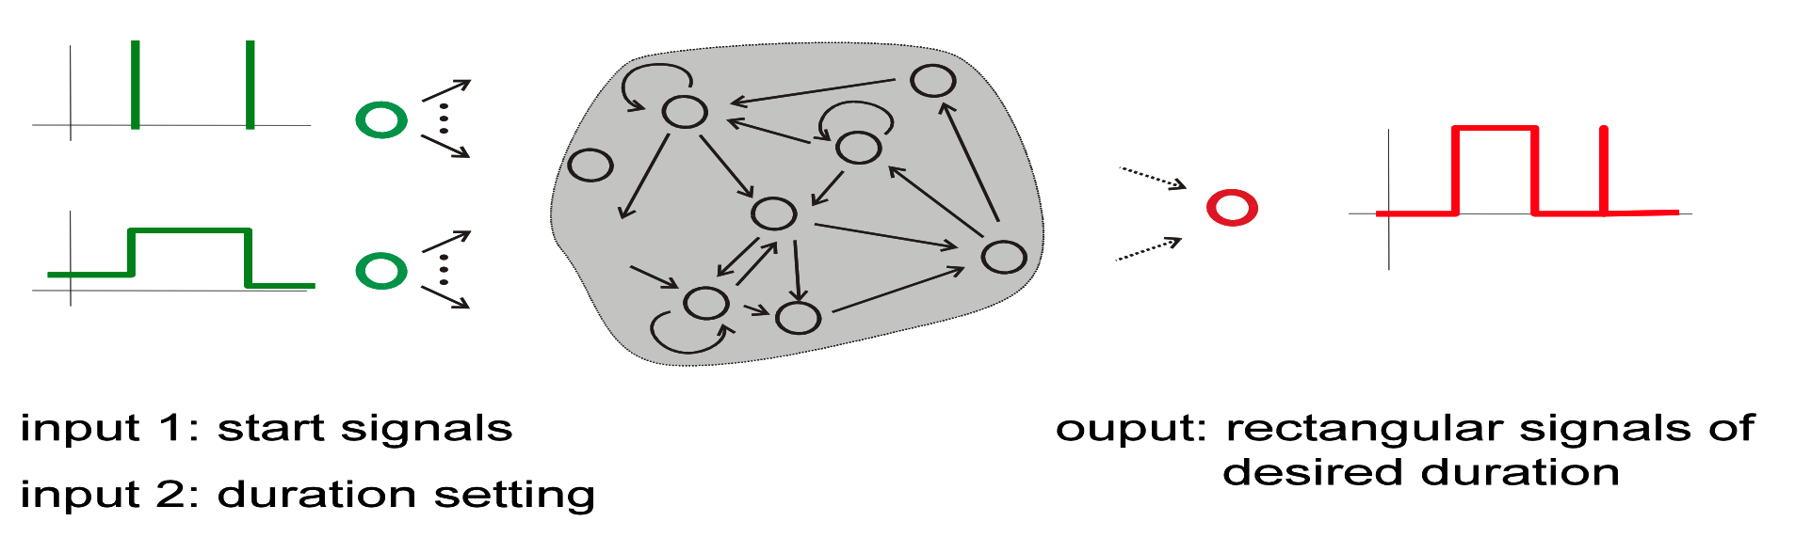
Example: A little timer network
Consider the input-output task of timing.
The input signal has two components:
First: u1(n) is 0 most of the time, but sometimes jumps to 1.
Second: u2(n) can take values 0.1~1.0 in increments of 0.1, and assumes a new (random) of these values each time u1(n) jumps to 1.
The desired output:
Out: 0.5 for 10 x u2(n) time steps after u1(n) was 1, else is 0.
u1(n) gives the “go” signal for the timer
u2(n) gives the desired duration.

Slide 4
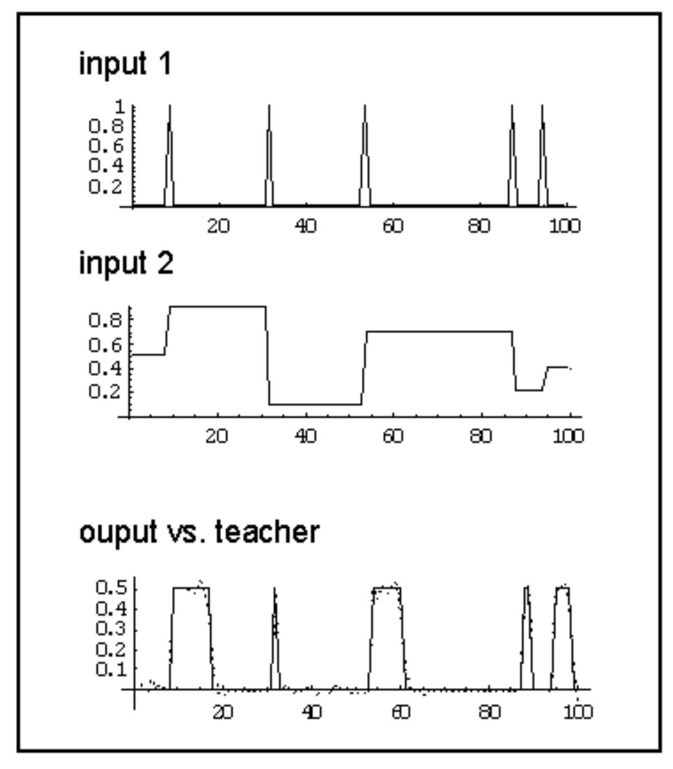
Example: A little timer network
Consider the input-output task of timing.
“Go”
Duration
Solid line: ground-truth output.
Dotted line: network output.

Slide 5
Example: A little timer network
Consider the input-output task of timing.
“Go”
Duration
To implement this, what king of property should the network have?
Solid line: ground-truth output.
Dotted line: network output.

Slide 6
Example: A little timer network
The task requires that the RNN must act as a memory: it has to retain information about the “go” signal for several time steps.
This is possible because the internal recurrent connections let the “go” signal “reverberate” in the internal units’ actions.
Generally, task requiring some form of memory are candidates for RNN modeling.

Slide 7
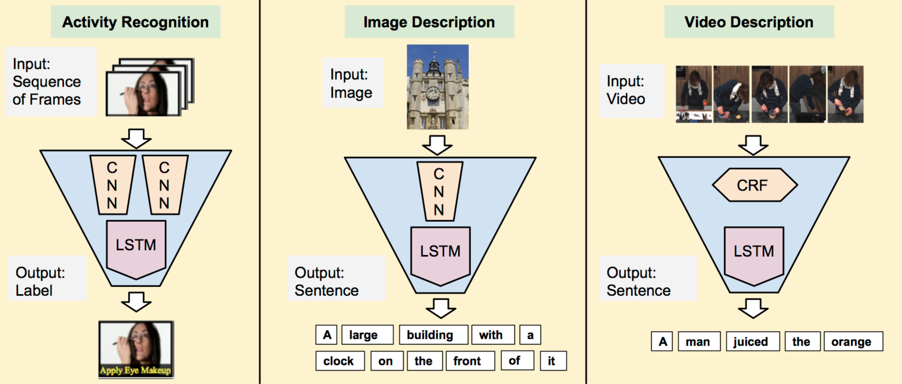
Where memory is needed?
Donahue et al. 2015

Slide 8

Recurrent Neural Networks
A simple RNN.
An unrolled recurrent neural network
Credit: C. Colah’s tutorial on LSTMs

Slide 9
Recurrent Neural Networks
A simple RNN.
An unrolled recurrent neural network
Credit: C. Colah’s tutorial on LSTMs

Slide 10

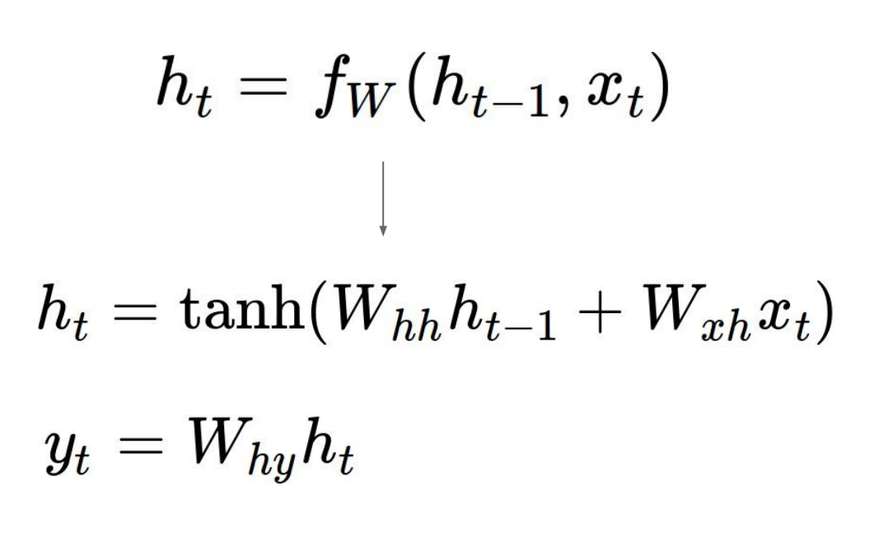
Recurrent Neural Networks
Inside of a simple RNN unit.
The state consists of a single “hidden” vector h:
Credit: C. Colah’s tutorial on LSTMs

Slide 11
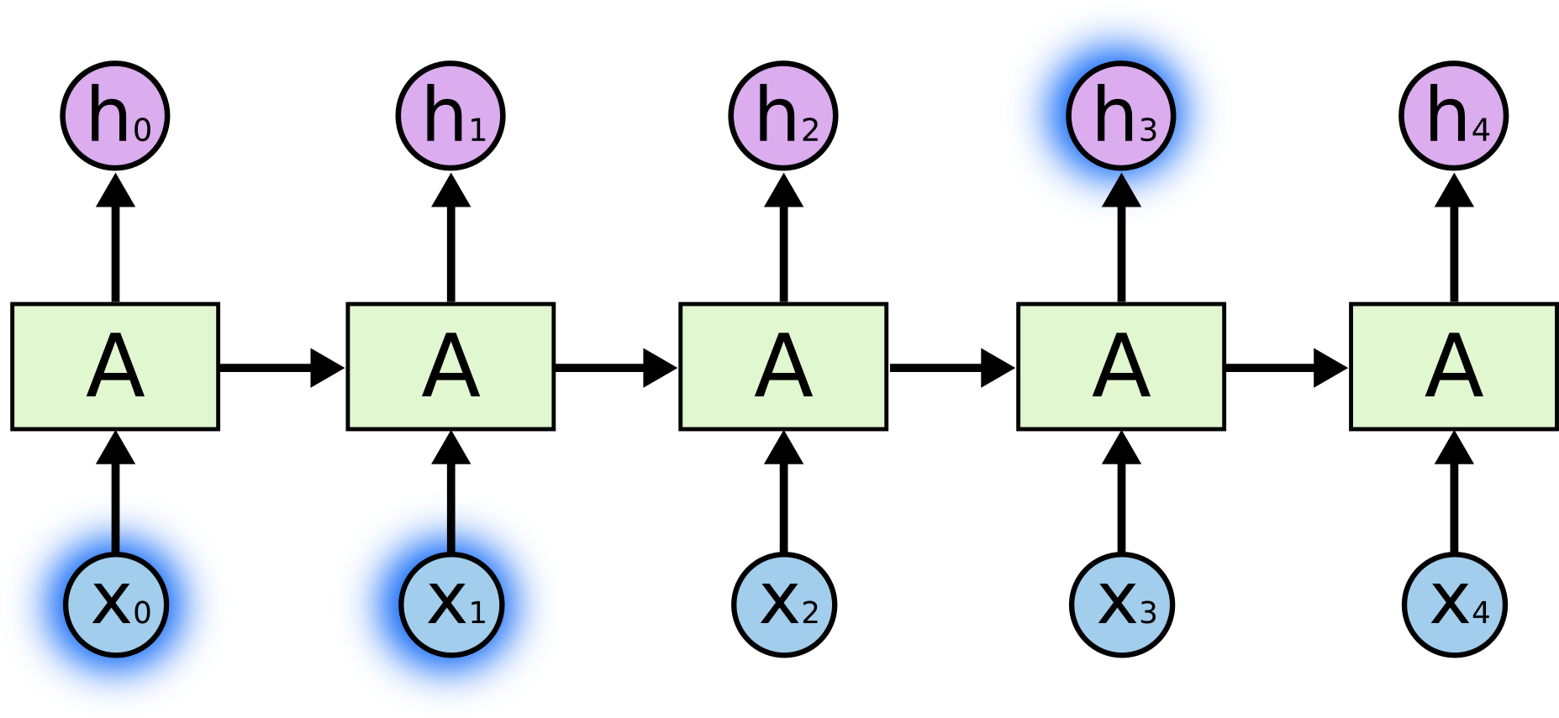
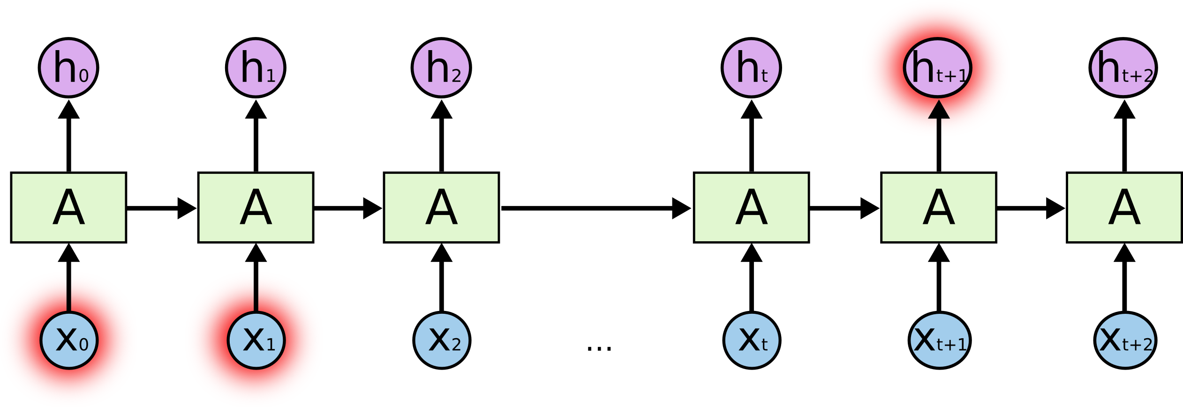
Recurrent Neural Networks
The clouds are in the sky.
I grew up in France… (some texts)… I speak fluent French.
Use RNN to learn long-term dependencies with gradient descent is difficult. [Bengio et al. 1994]
http://www-dsi.ing.unifi.it/~paolo/ps/tnn-94-gradient.pdf
Difficult to handle long-term dependencies
Solution?

Slide 12


Long Short Term Memory networks (LSTM)
Inside of a LSTM unit.
Credit: C. Colah’s tutorial on LSTMs

Slide 13

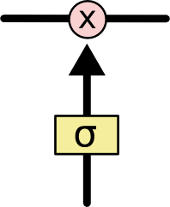
The Core Idea Behind LSTMs
The cell state is kind of like a conveyor belt. It runs straight down the entire chain, with only some minor linear interactions.
The LSTM has the ability to remove or add information to the cell state, carefully regulated by structures called gates.
A pointwise multiplication operation.
Sigmoid layer output numbers between 0 and 1.
- All zeros: “let nothing through”.
- All ones: “let everything through!”.
Credit: C. Colah’s tutorial on LSTMs

Slide 14

Step-by-Step LSTM Walk Through
Decide what information to throw away from the cell state.
Forget gate layer.
Credit: C. Colah’s tutorial on LSTMs

Slide 15

Step-by-Step LSTM Walk Through
Decide what new information to store in the cell state.
Input gate layer.
Input modulation gate layer.
Which values to update.
New candidate value.
Credit: C. Colah’s tutorial on LSTMs

Slide 16

Step-by-Step LSTM Walk Through
It’s now time to update the old cell state into new cell state.
Forget what we decided to forget.
Add new candidate value scaled by how much we decided to update each state value.
Credit: C. Colah’s tutorial on LSTMs

Slide 17

Step-by-Step LSTM Walk Through
Finally, we need to decide what to output.
Output gate layer.
What parts of the cell state to output.
Push value between -1 and 1.
Output and also recurrent.
Credit: C. Colah’s tutorial on LSTMs

Slide 18
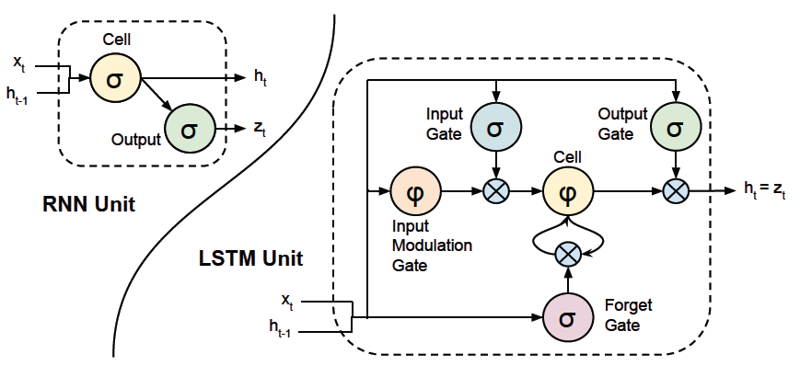
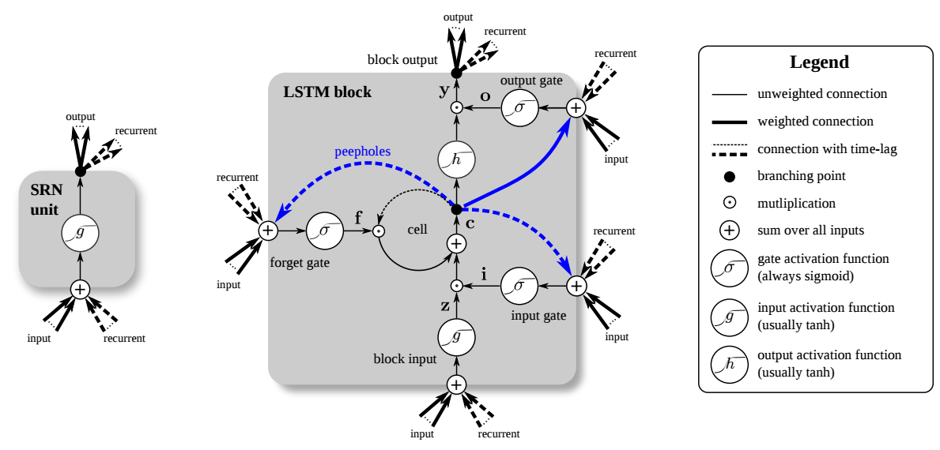
Long Short Term Memory networks (LSTM)
Other graphs you may see …

Slide 19
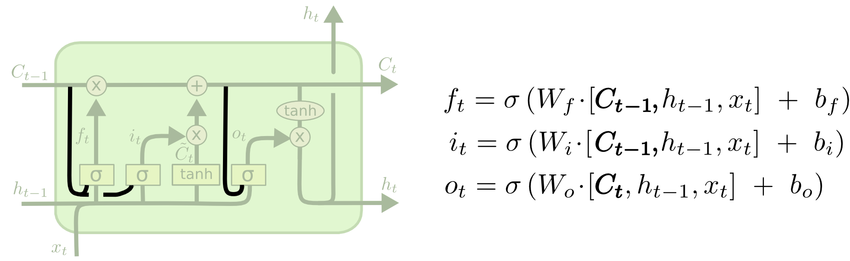
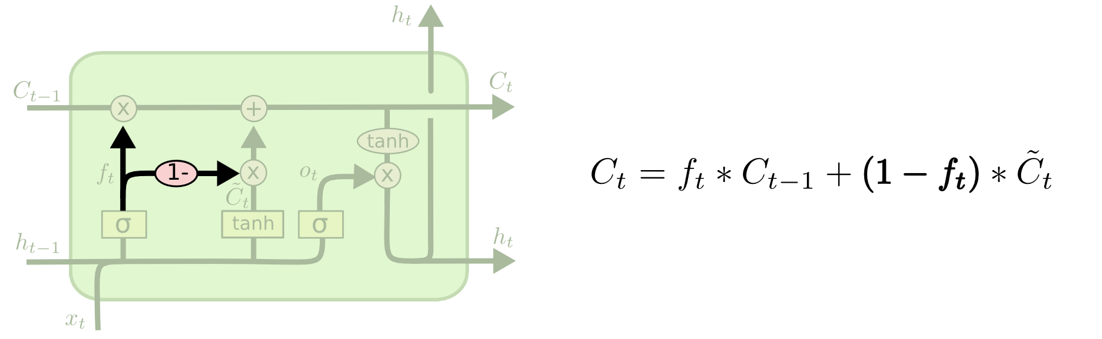

Variants on LSTMs
“peephole connections”: let the gate layers look at the cell state.
Tied forget and input gates.
Gated Recurrent Unit
Credit: C. Colah’s tutorial on LSTMs

Slide 20
Cool demo
http://cs.stanford.edu/people/karpathy/recurrentjs/

Slide 21
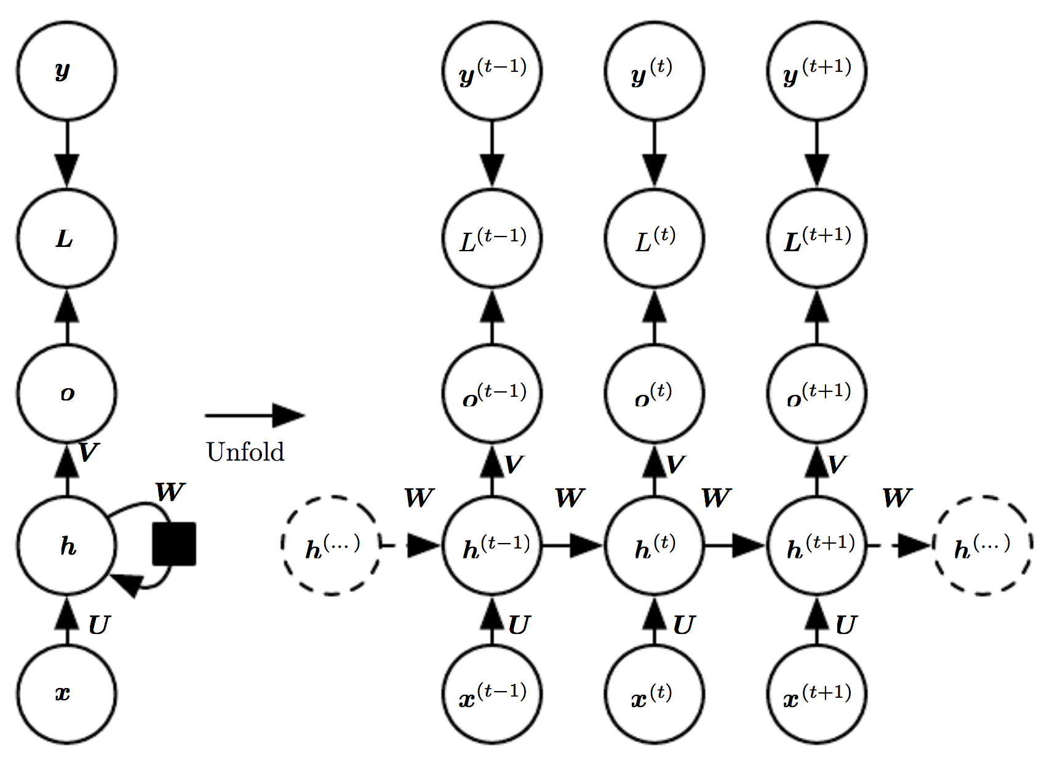
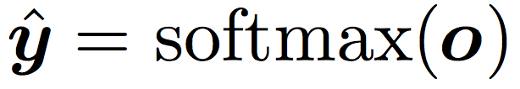
Design Patterns of RNNs
RNNs that produce an output at each time step and have recurrent connections between hidden units.
Training Target
Loss
Output Sequence
Hidden Units
Input Sequence
U → Weights: input-to-hidden
W → Weights: hidden-to-hidden
V → Weights: hidden-to-output

Slide 22
Design Patterns of RNNs
RNNs that produce an output at each time step and have recurrent connections between hidden units.
Training Target
Loss
Output Sequence
Hidden Units
Input Sequence
U → Weights: input-to-hidden
W → Weights: hidden-to-hidden
V → Weights: hidden-to-output
Each is one particular time instance.

Slide 23
Design Patterns of RNNs
RNNs that produce an output at each time step and have recurrent connections between hidden units.
Training Target
Loss
Output Sequence
Hidden Units
Input Sequence
BPTT
U → Weights: input-to-hidden
W → Weights: hidden-to-hidden
V → Weights: hidden-to-output

Slide 24
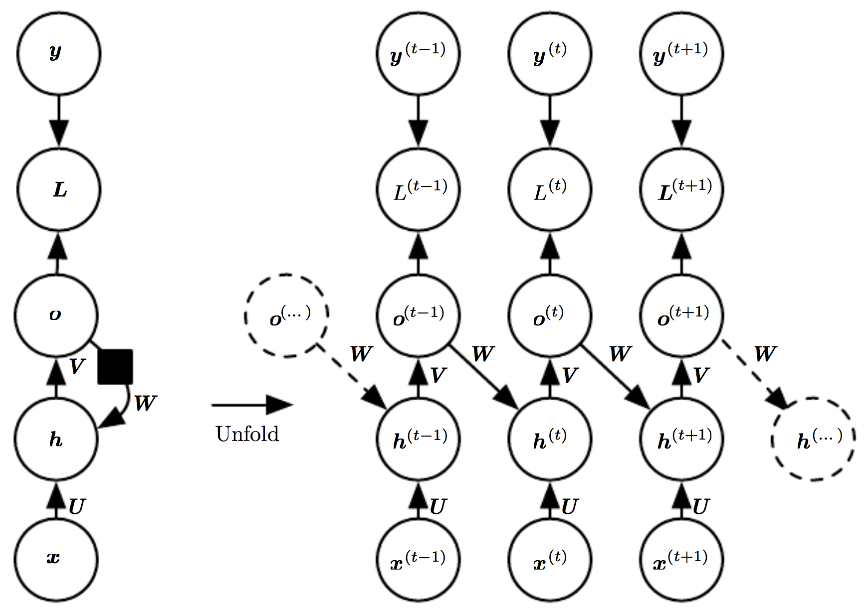
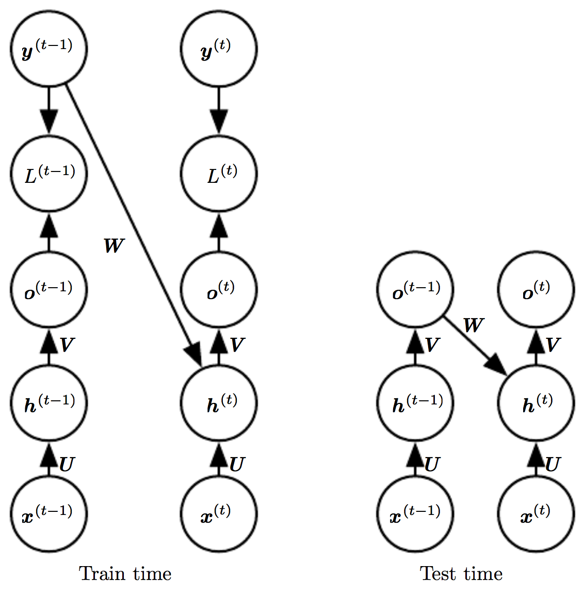
Design Patterns of RNNs
RNNs that produce an output at each time step and have recurrent connections only from the output at one time step to the hidden units at the next time step.
Less powerful due to the lack of hidden-to-hidden recurrent connections.
Training can be parallelized by teacher forcing as all the time steps are decoupled in training.
Teacher Forcing

Slide 25
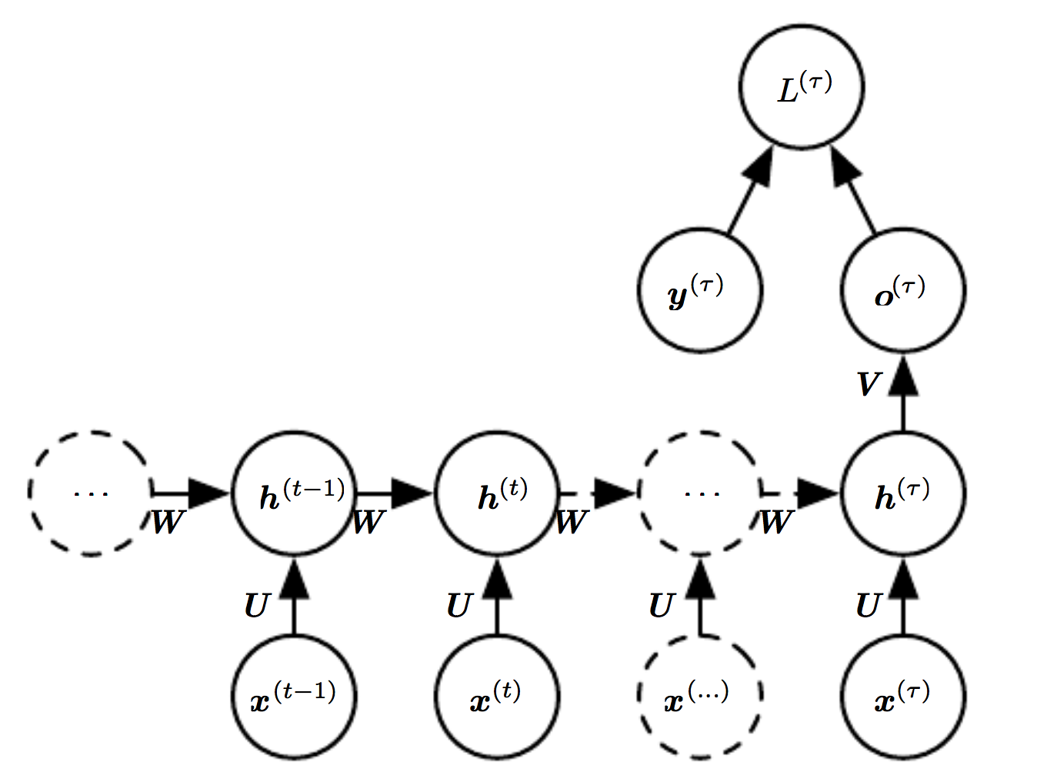
Design Patterns of RNNs
RNNs with recurrent connections between hidden units, that read an entire sequence and then produce a single output.
Such a network can be used to summarize a sequence and produce a fixed-sized representation used as input for further processing.
unfold

Slide 26
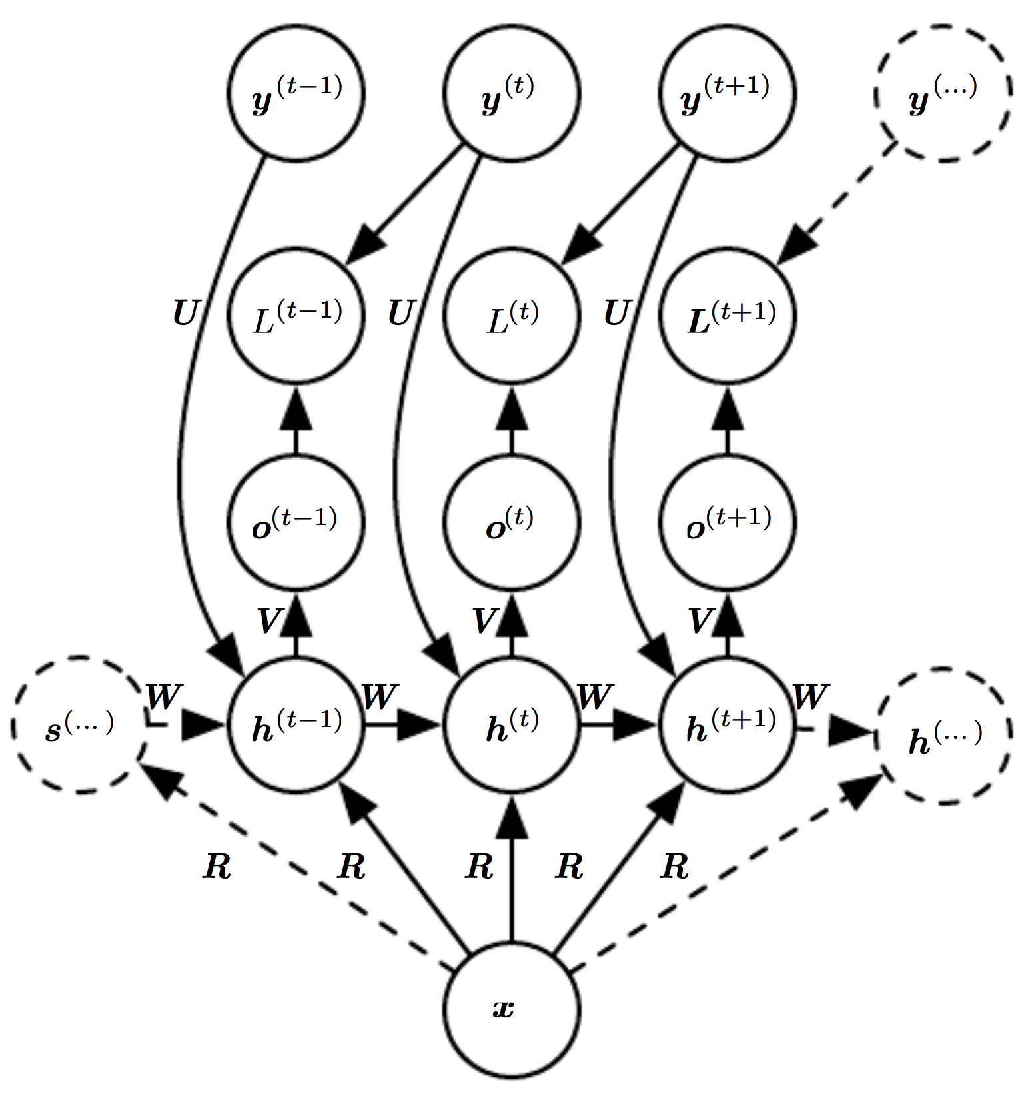
Design Patterns of RNNs
RNNs that maps a fixed-length vector x into a distribution over sequences Y.
Each element y of the observed output sequences serves both as input (for the recurrent time step) and, during training, as target (for the previous time step).

Slide 27
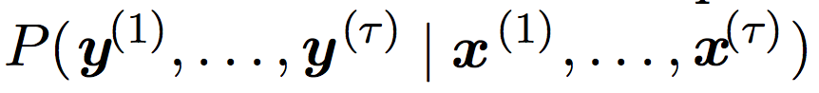
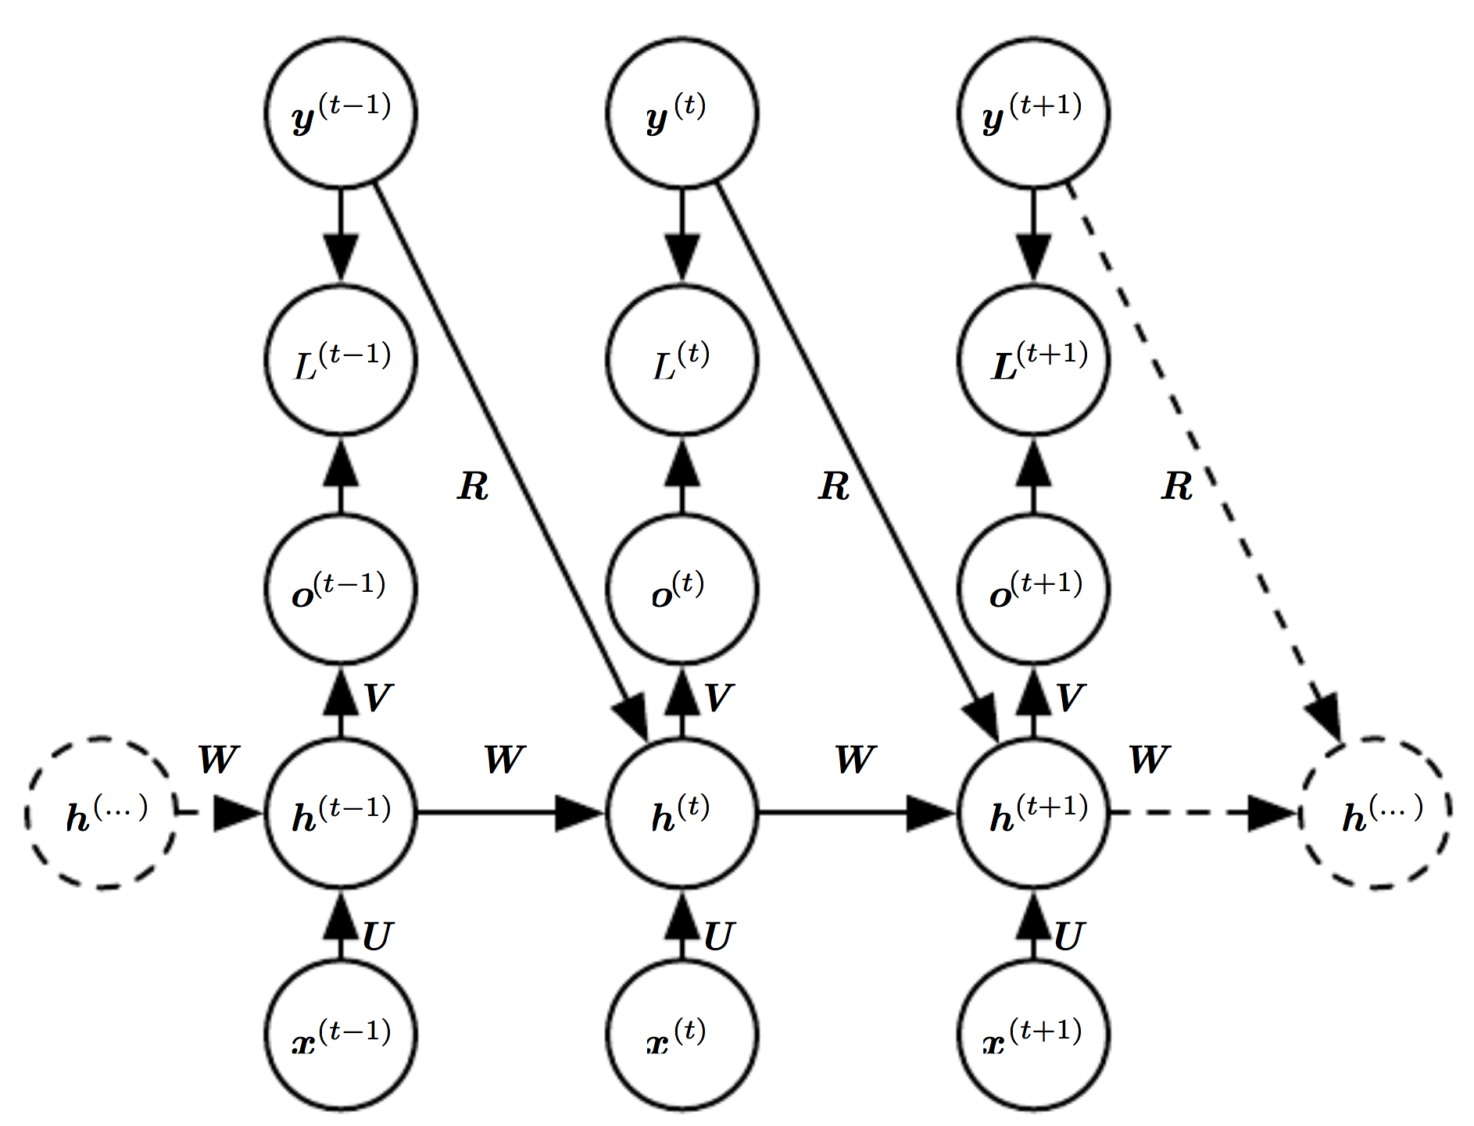
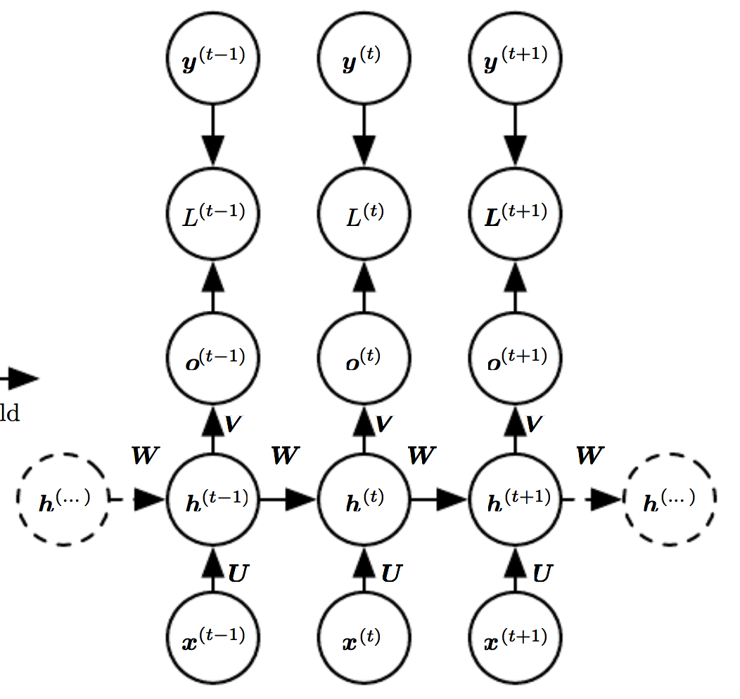
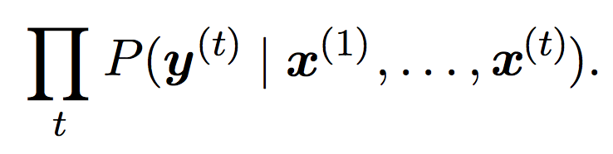
Design Patterns of RNNs
A conditional RNN that contains connections from the previous output to the current state.
These connections allow this RNN to model an arbitrary distribution over sequences of y given sequences of x of the same length.
Recall:
Independent
assumption:
Notes:
Chain rule of conditional probability

Slide 28
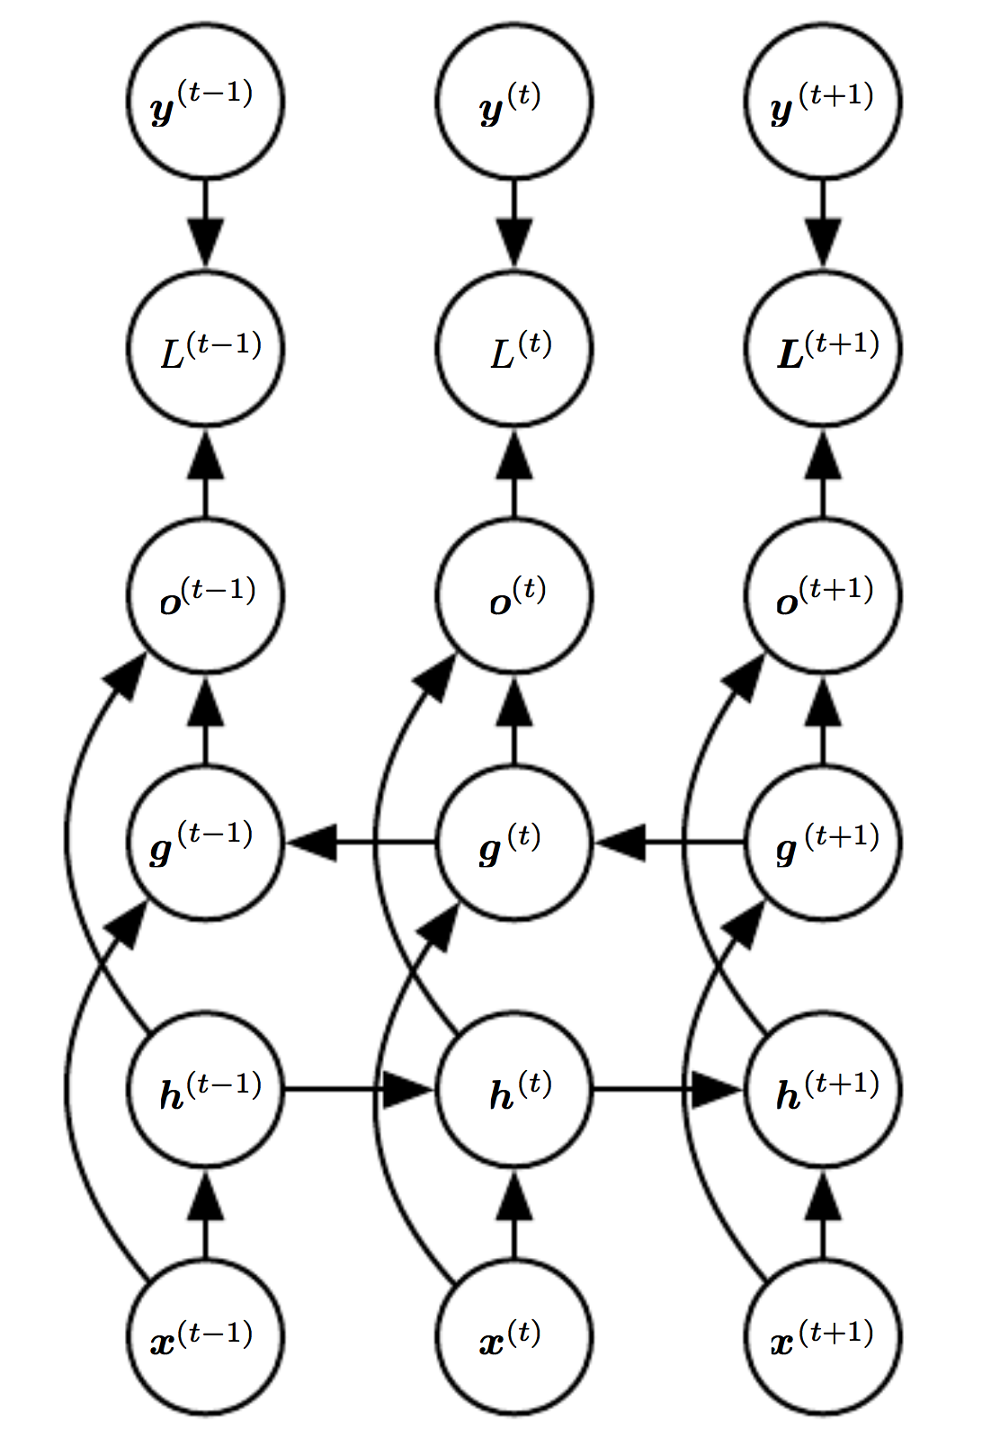
Bidirectional RNNs
All RNNs we have considered up to now have a “causal” structure: the state at time t captures only past information from 1 to t.
Does not fit cases where y depends on the whole input sequence, i.e., look far into the future (and the past).
Combines an RNN that moves forward through time, beginning from the start of the sequence, with another RNN that moves backward through time.
This works in 1D data.
How do we model 2D data?
Backward RNN
Forward RNN

Slide 29
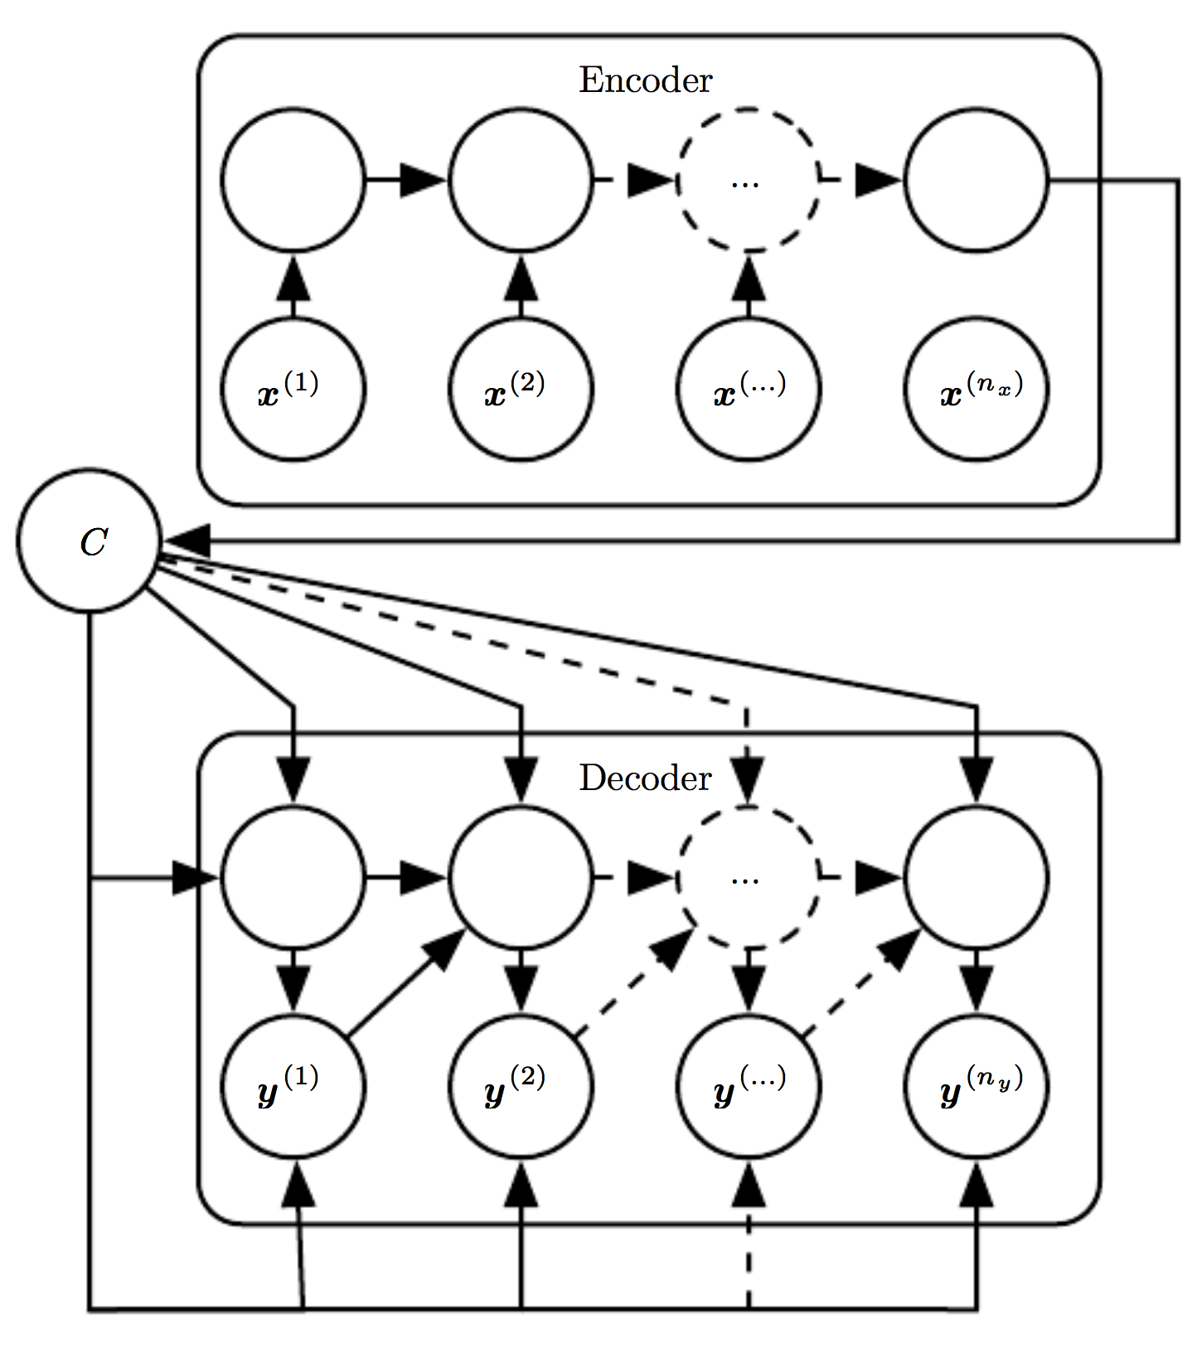
Encoder-Decoder Sequence-to-Sequence Arch.
RNNs that map a variable-length sequence to another variable-length sequence.
An encoder/reader/input RNN
The “context” represents a semantic summary of the input sequence and is given as input to the decoder RNN.
A decoder/writer/output RNN

Slide 30
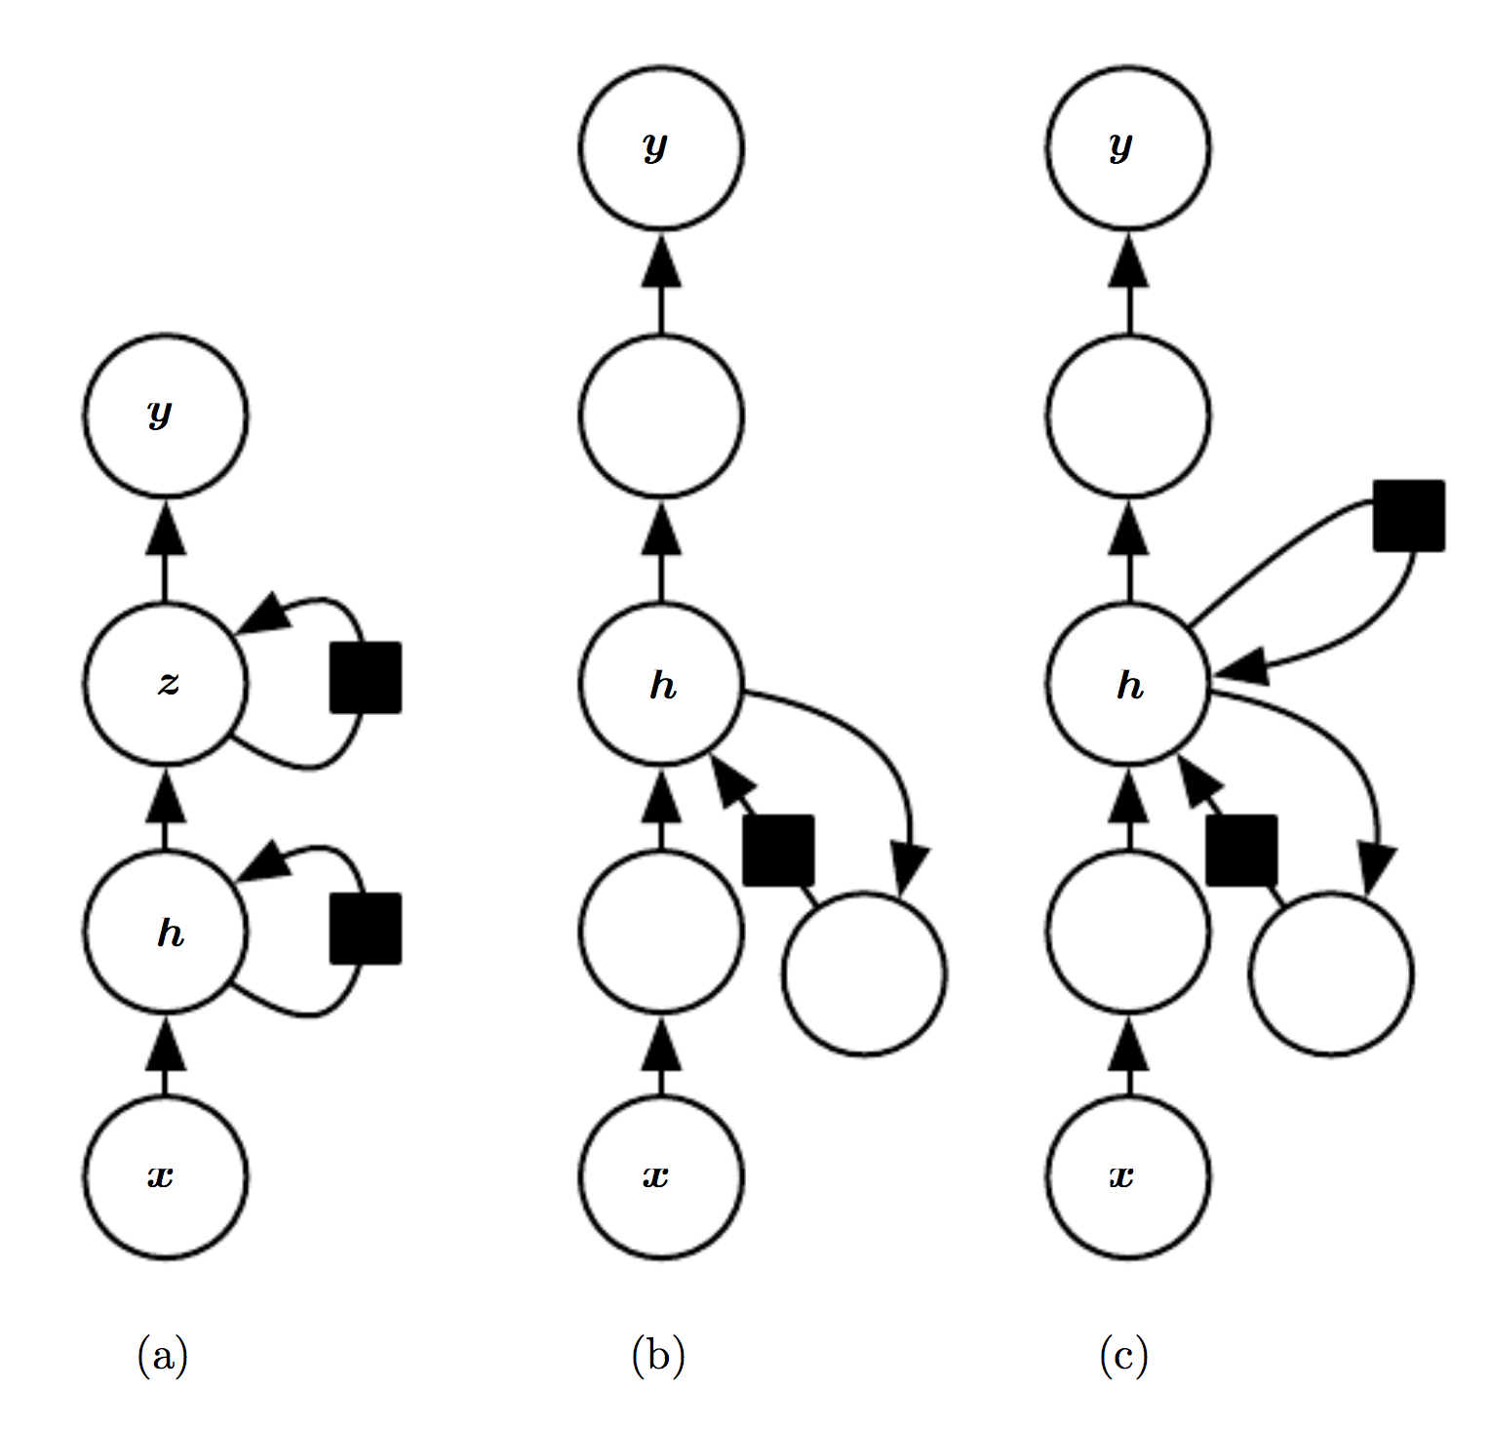
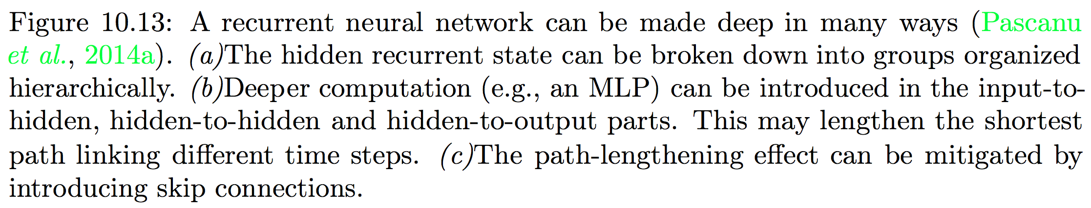
Deep Recurrent Networks

Slide 31
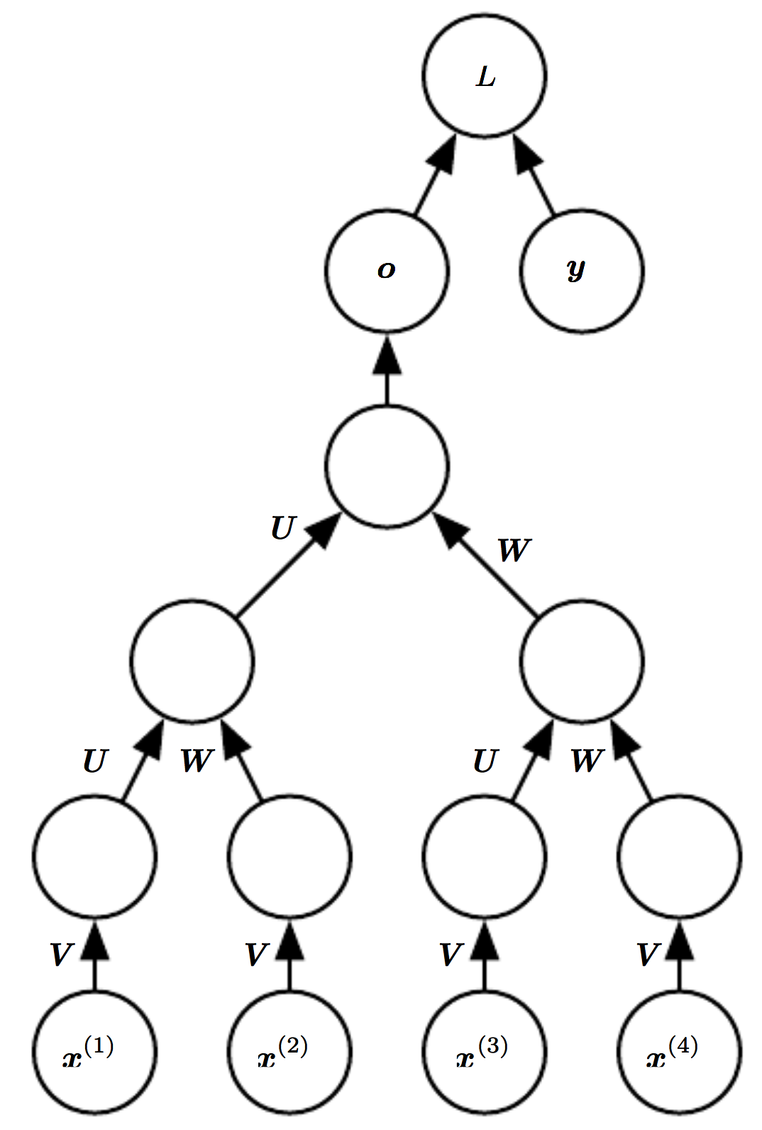
Recursive Neural Networks
One clear advantage of recursive nets over recurrent nets is that for a sequence of the same length t, the depth (measured as the number of compositions of nonlinear operations) can be drastically reduced from t to O(log t), which might help deal with long-term dependencies.
Open question: how to best structure the tree?
Recall:

Slide 32
Summary
Feedforward v.s. Recurrent NN
A little timer network
Simple RNN
Long Short-Term Memory networks (LSTM)
Different design patterns of RNNs
Next lecture 3/19:
Examples of using RNNs in computer vision tasks
Image Captioning HW4

